Slide 1
Getting Started with PowerShell 6
Section 1

Slide 2
In this Section, we are going to take a look at…
Setting up a lab for PowerShell learning and testing
Accessing the PowerShell console and ISE environments
Accessing and updating the help system
Finding and running Cmdlets
Using the help system and protecting with -WhatIf and -Confirm

Slide 3
Setting Up a Lab

Slide 4
In this Video, we are going to take a look at…
Why is a lab necessary
Items required for a lab
Physical or virtual machines
Types of hypervisors
Virtual switch types
Application and windows features

Slide 5
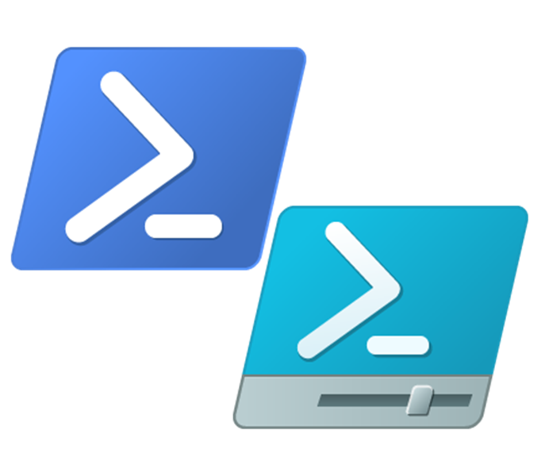
Why Is a Lab Necessary?
A lab environment allows for learning by trying and testing safely without affecting any production systems
You can try things and make changes at will where you could not in a production environment without affecting users

Slide 6
Items Required for a Lab
A group of physical computers and network equipment or preferably a hypervisor with virtual switches and machines

Slide 7
Items Required for a Lab
A group of physical computers and network equipment or preferably a hypervisor with virtual switches and machines
ISO files from Microsoft’s evaluation center for Windows 10 Enterprise, Server 2012r2, and Server 2016

Slide 8
Items Required for a Lab
A group of physical computers and network equipment or preferably a hypervisor with virtual switches and machines
ISO files from Microsoft’s evaluation center for Windows 10 Enterprise, Server 2012r2, and Server 2016
A guide or previous experience setting up the lab environment

Slide 9
Items Required for a Lab
A group of physical computers and network equipment or preferably a hypervisor with virtual switches and machines
ISO files from Microsoft’s evaluation center for Windows 10 Enterprise, Server 2012r2, and Server 2016
A guide or previous experience setting up the lab environment
Links to a lab setup guide and the Microsoft evaluation center can be found at: powershellnewbie.com/resources

Slide 10
Physical or Virtual Machines
Network switch
Server machine
Client machine(s)
Provides connectivity between lab machines while isolating them from all other machines
Should include at minimum one domain controller and one app server. Can be a mix of Server 2012r2 and Server 2016 or all 2016
One is necessary to use as you would a production workstation. Multiple can be used for tests requiring an environment that has clients
Notes:
This is a step-wise graphical info type slide.

Slide 11
Hypervisor
“A hypervisor or Virtual Machine Monitor (VMM) is computer software, firmware, or hardware that creates and runs virtual machines. A computer on which a hypervisor runs one ore more virtual machines is called a host machine, and each virtual machine is called a guest machine.” -Wikipedia

Slide 12
Hypervisor Options
VMWare ESXi (Type one)
VMWare workstation or fusion (Type two)
Microsoft Hyper-V (Type one or two)
Virtual box (Type two)

Slide 13
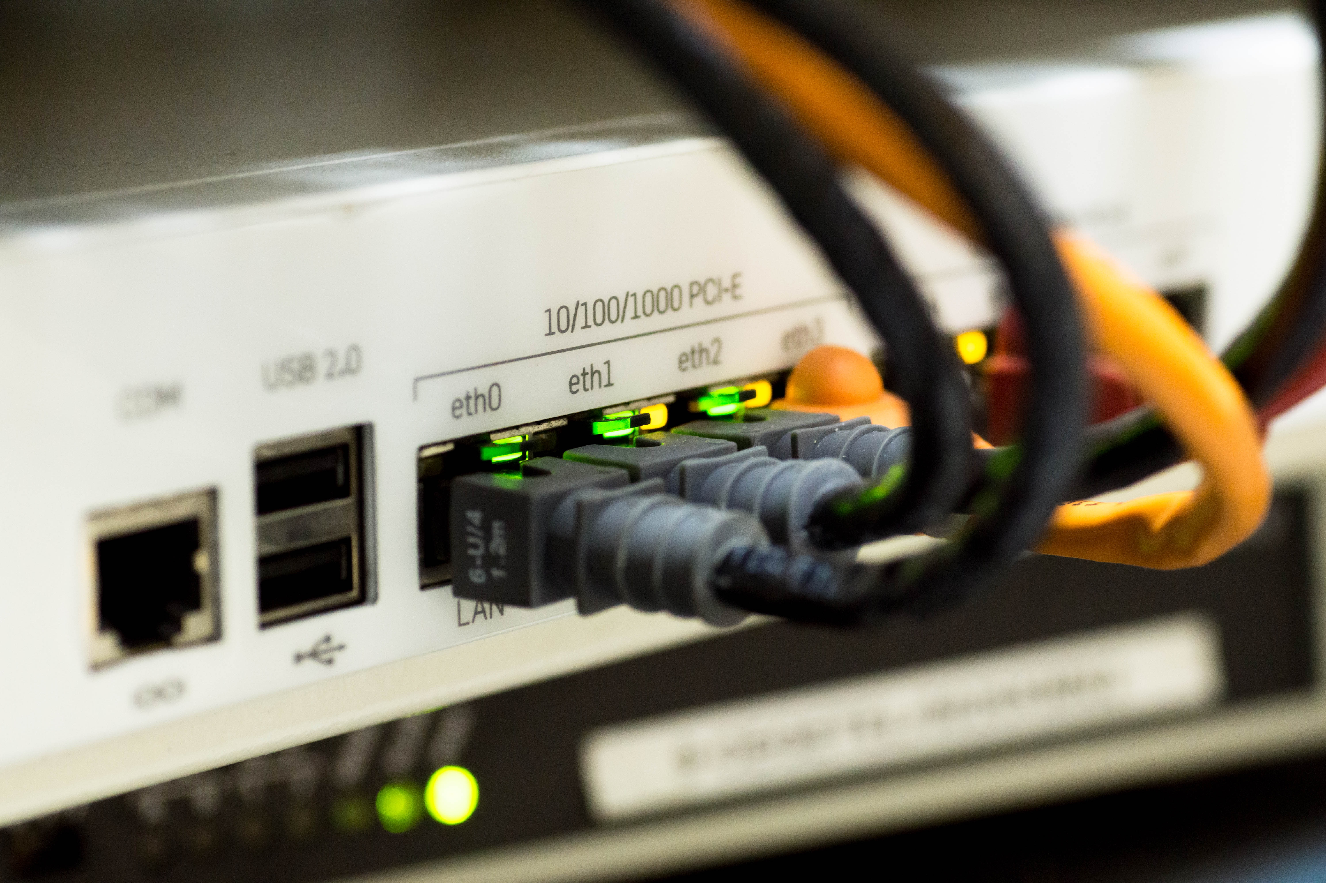
Virtual Switch Types
External, NAT, Bridged
Notes:
Like mentioned – best for flowcharts, block diagram, and images in the split-view of course!

Slide 14
Virtual Switch Types
External, NAT, Bridged
Internal or Host-only
Notes:
Like mentioned – best for flowcharts, block diagram, and images in the split-view of course!

Slide 15
Virtual Switch Types
External, NAT, Bridged
Internal or Host-only
Internal or Private
Notes:
Like mentioned – best for flowcharts, block diagram, and images in the split-view of course!

Slide 16
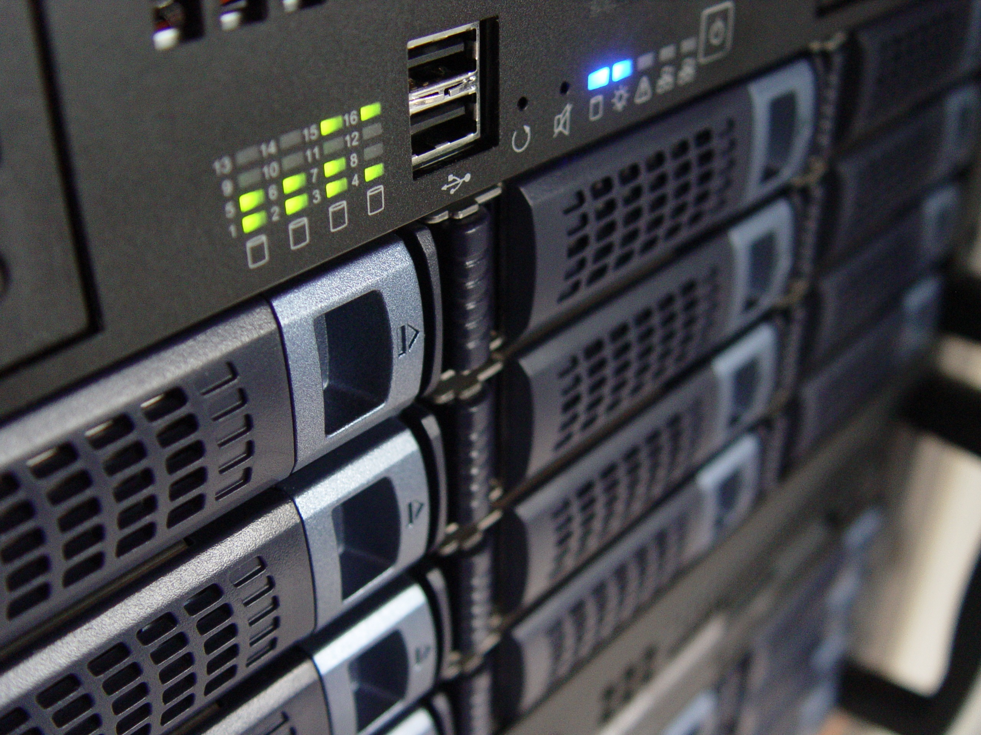
Applications and Features
Active Directory
Notes:
Like mentioned – best for flowcharts, block diagram, and images in the split-view of course!

Slide 17
Applications and Features
Active Directory
DHCP
Notes:
Like mentioned – best for flowcharts, block diagram, and images in the split-view of course!

Slide 18
Applications and Features
Active Directory
DHCP
Web Server (IIS)
Notes:
Like mentioned – best for flowcharts, block diagram, and images in the split-view of course!

Slide 19

Keep the Lab Isolated!

Slide 20
Accessing the PowerShell Console and PowerShell ISE
Next Video

